Slide 1
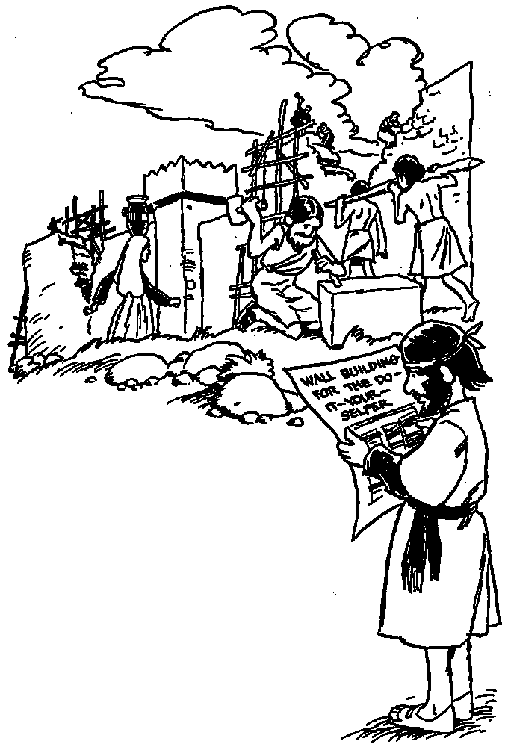
Nehemiah 1
Where God Guides, God Provides
Dr. Rick Griffith, Crossroads International Church Singapore
BibleStudyDownloads.org

Slide 2
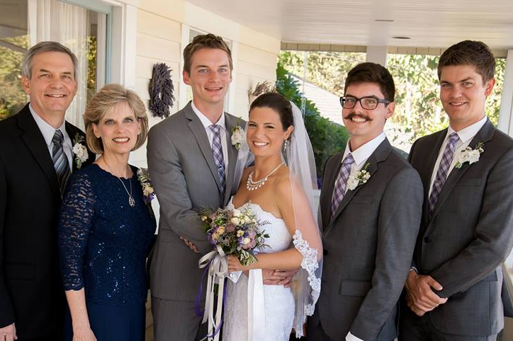
The Griffith Family
Sept 2014
2014
Rick
Stephen
25
Susan
John
22
Kurt & Cara
28

Slide 3
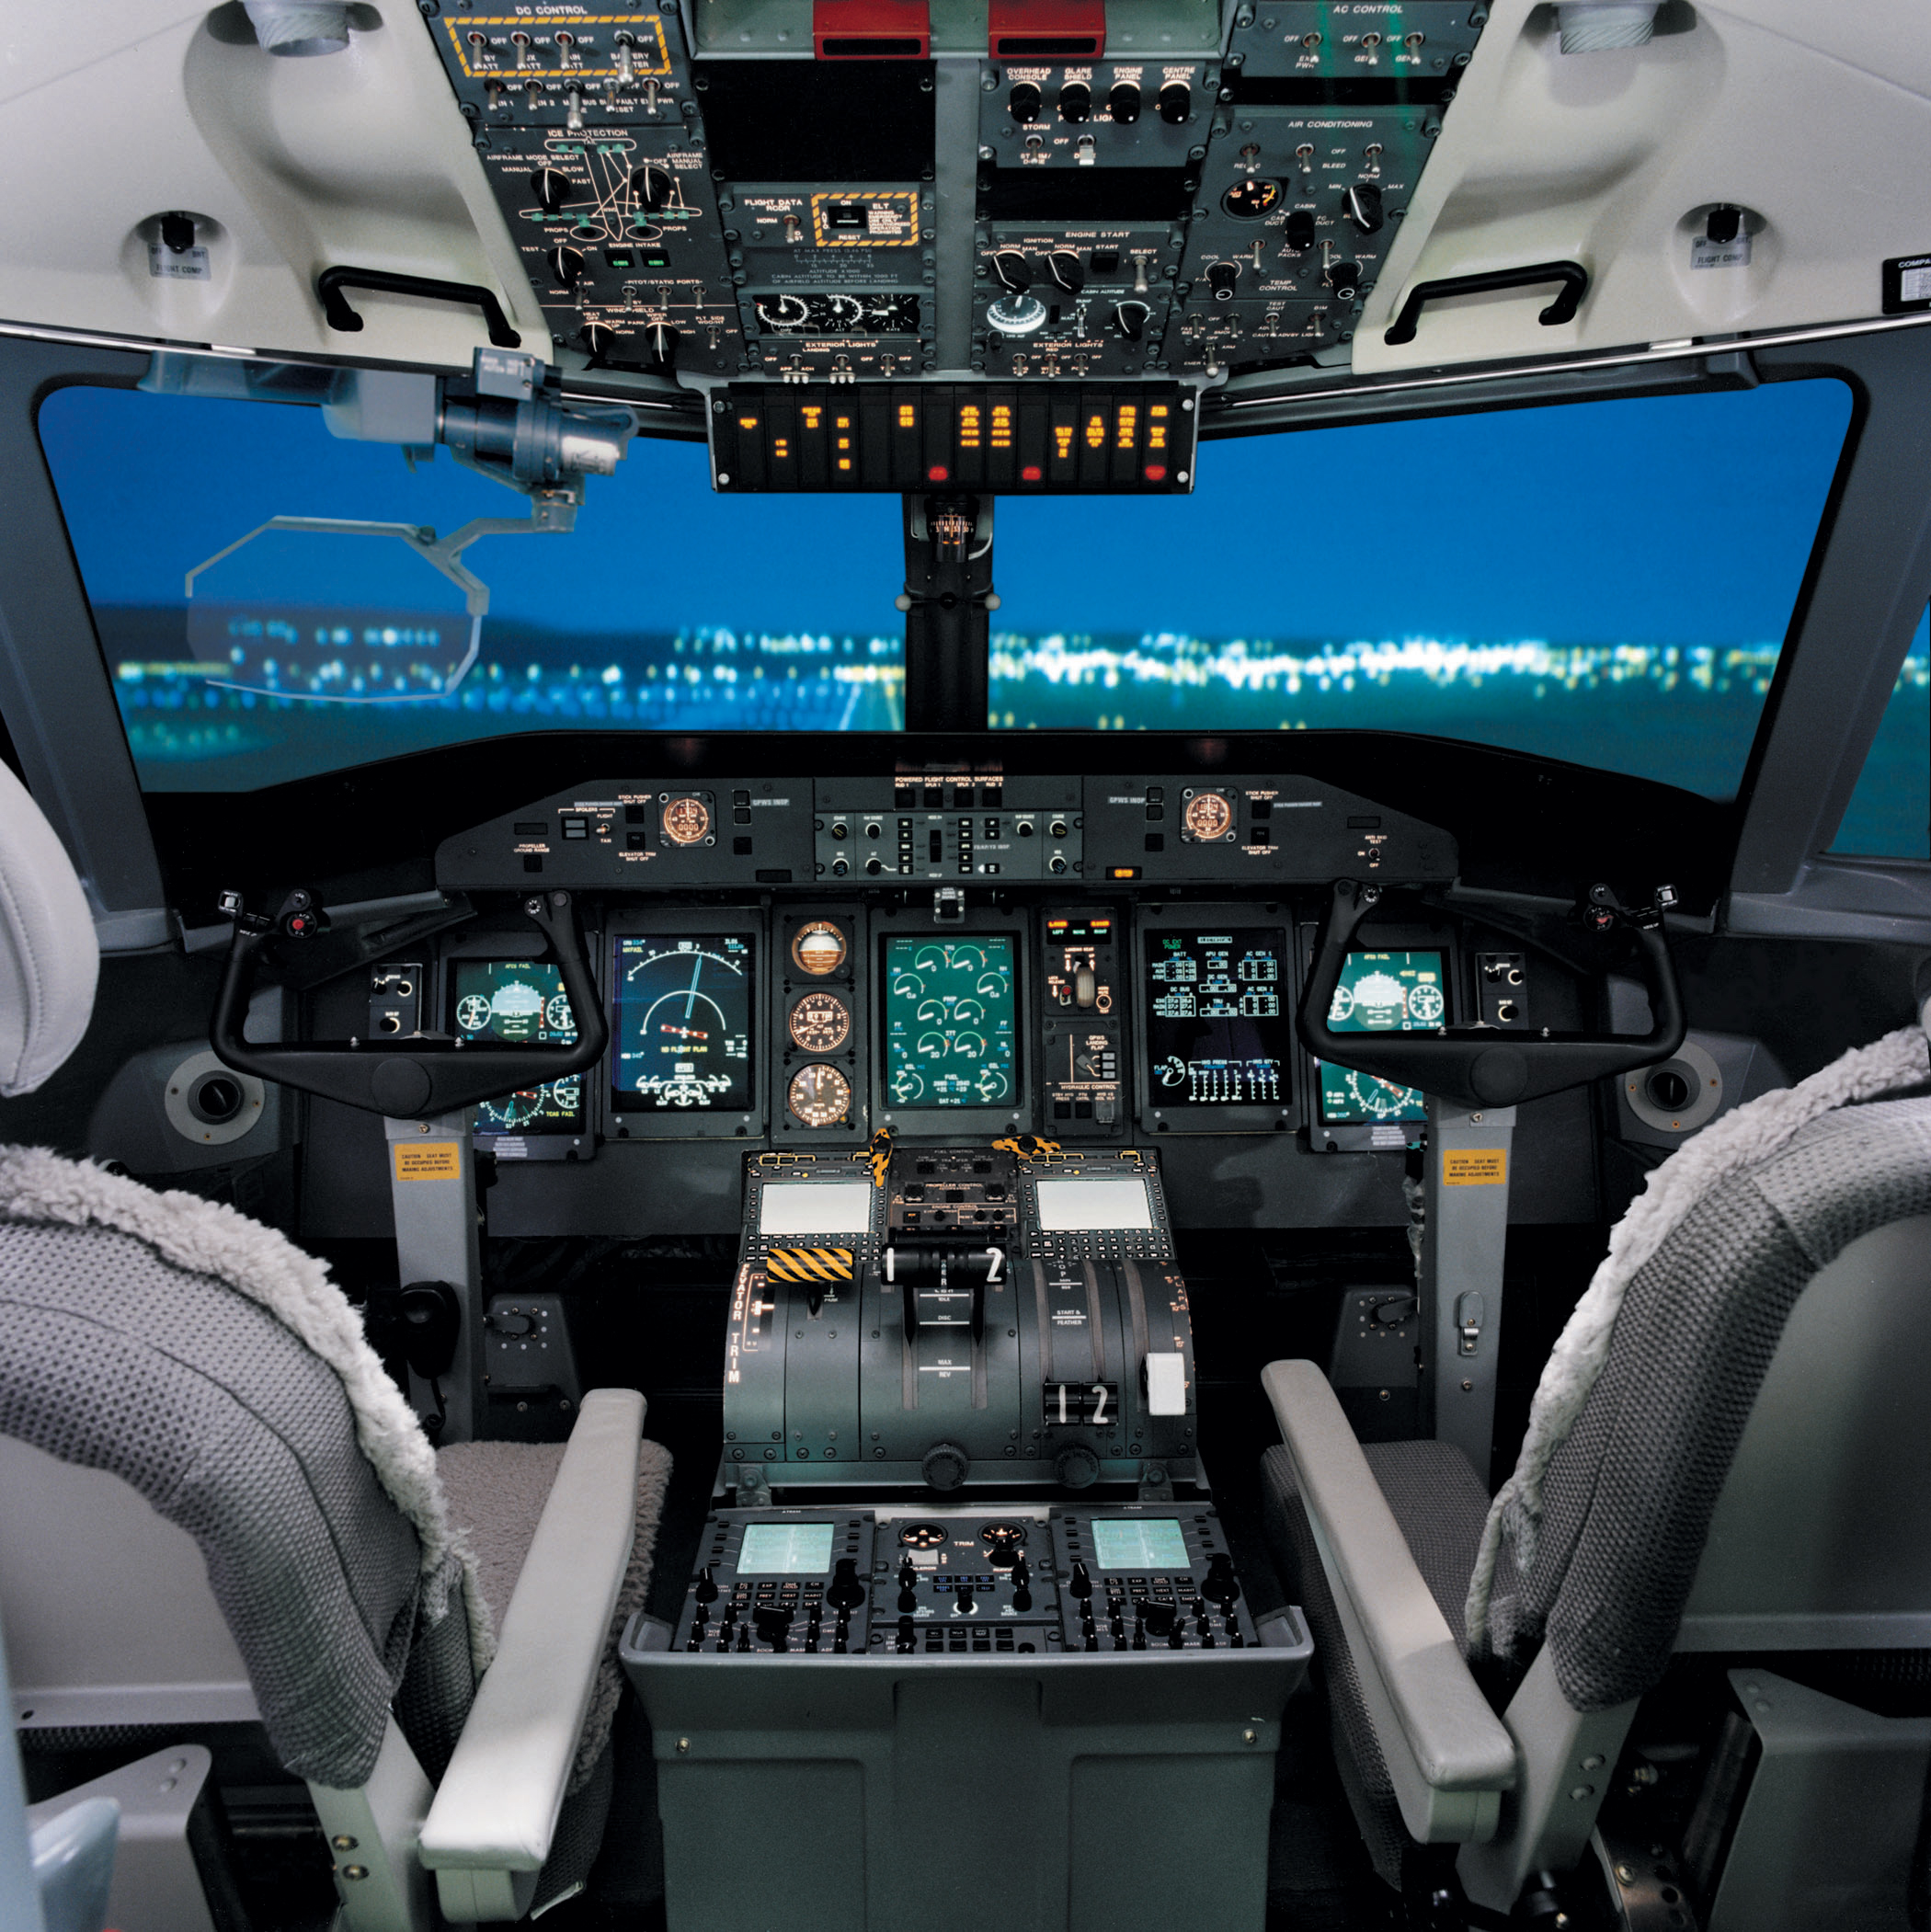
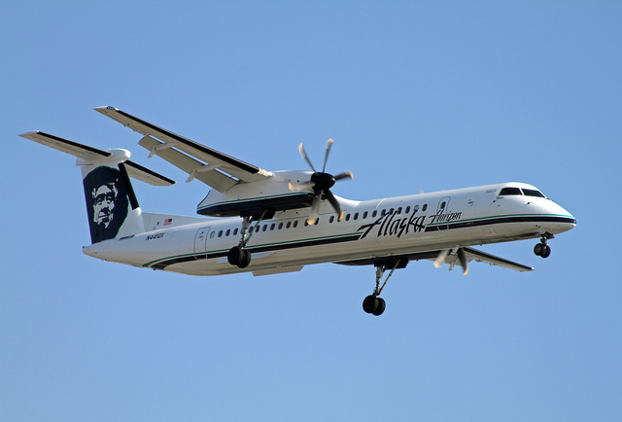
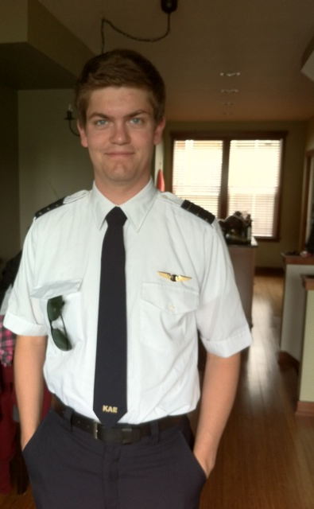
Stephen is a pilot with Horizon Air, Seattle
6

Slide 4
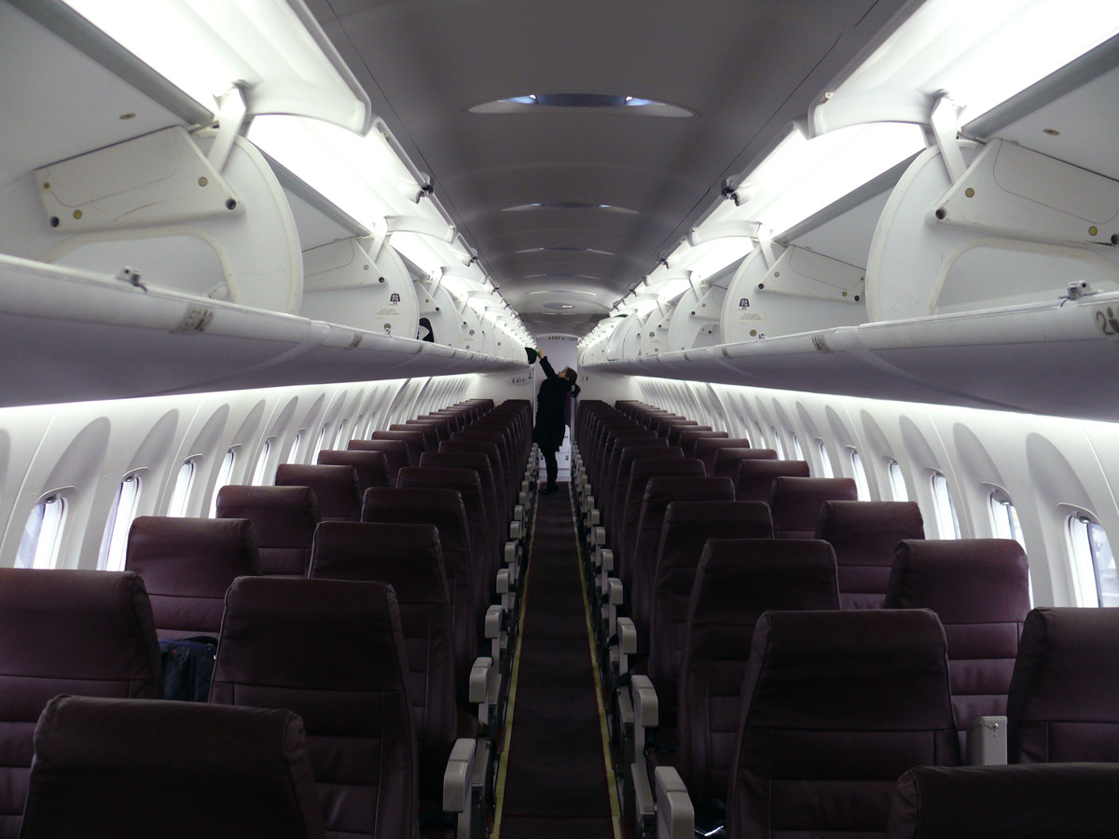
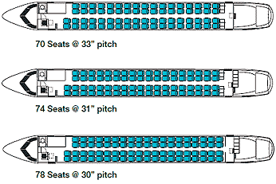
Stephen flies with Horizon Air
6

Slide 5
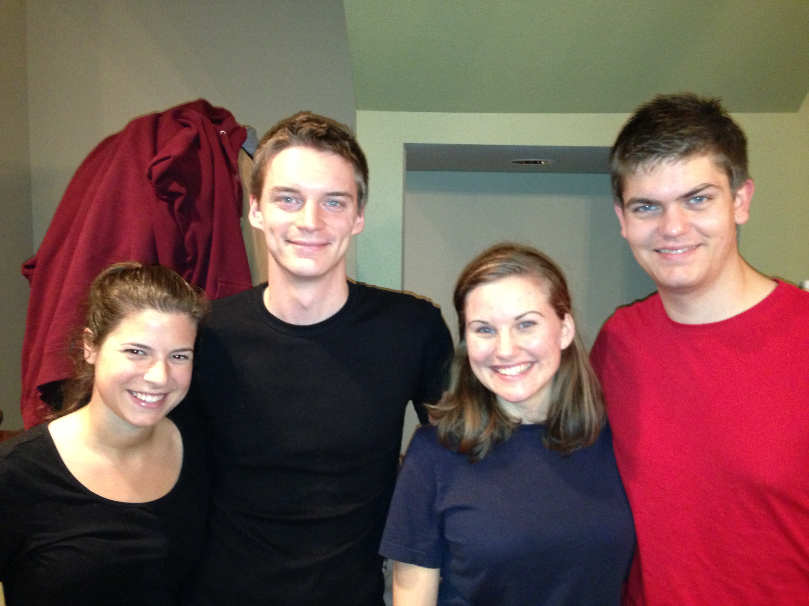
Cara & Kurt • Katie & Stephen

Slide 6
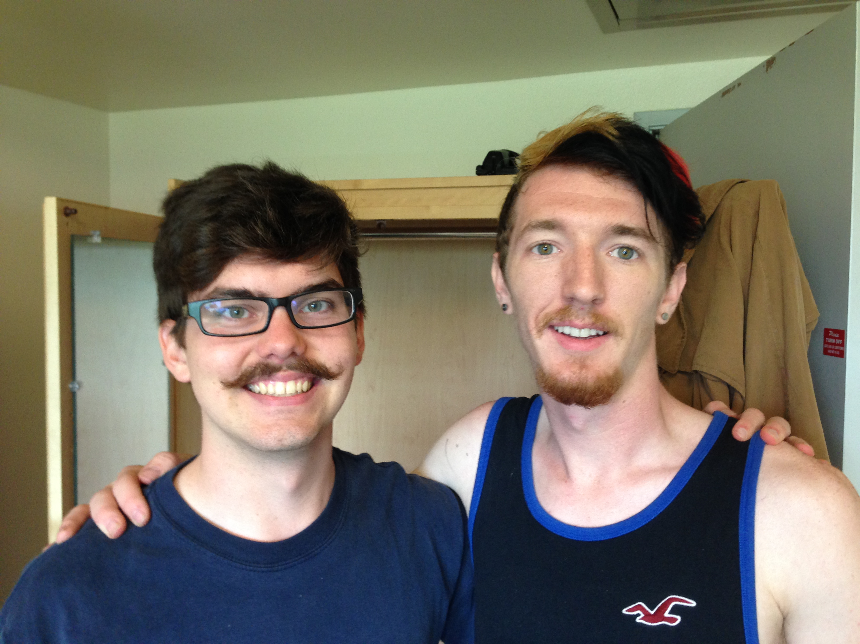
John at Biola University

Slide 7
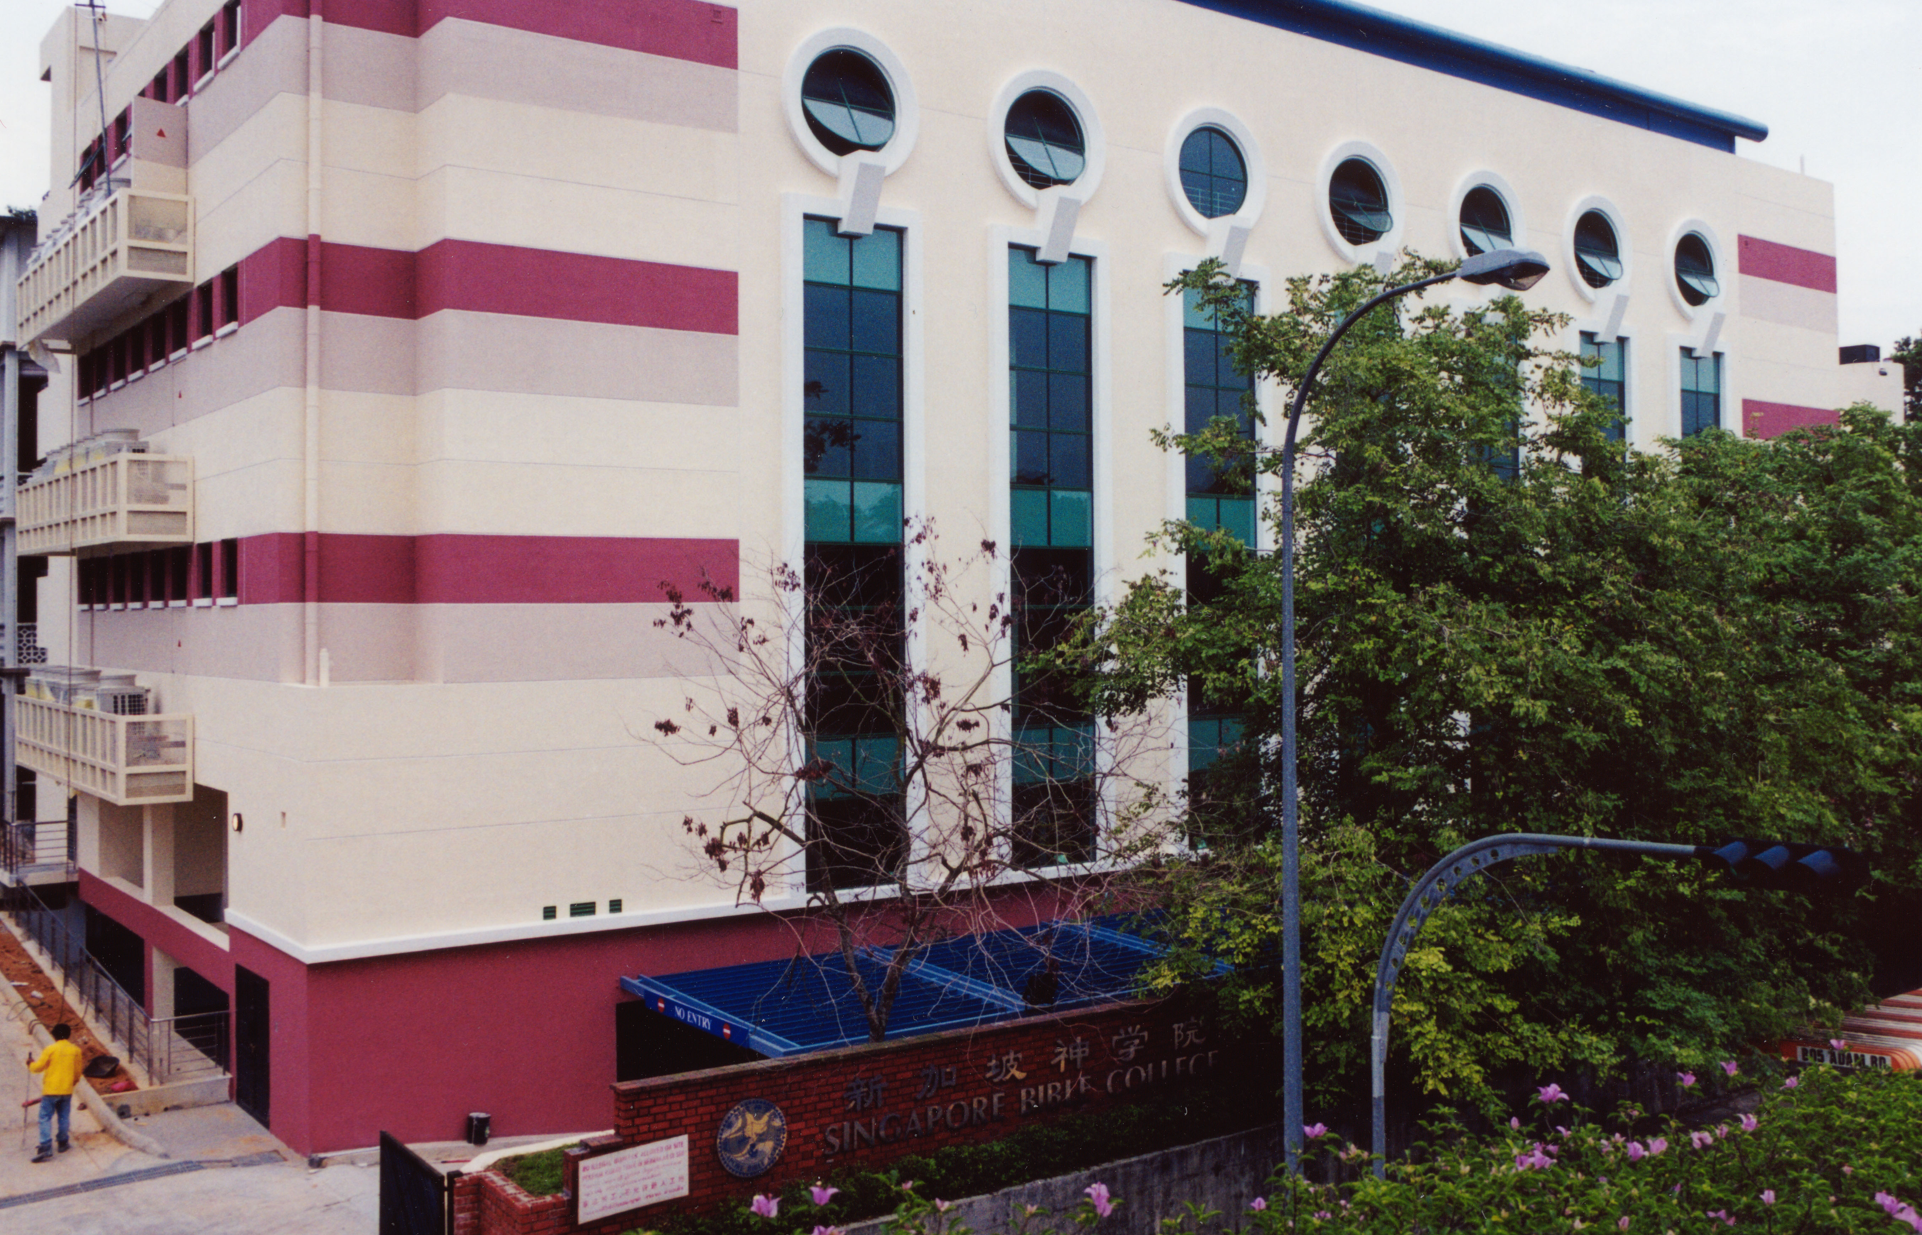
SINGAPORE BIBLE COLLEGE
Notes:
I've served as a seminary professor with 30 other faculty at Singapore's largest training school: Singapore Bible College

Slide 8
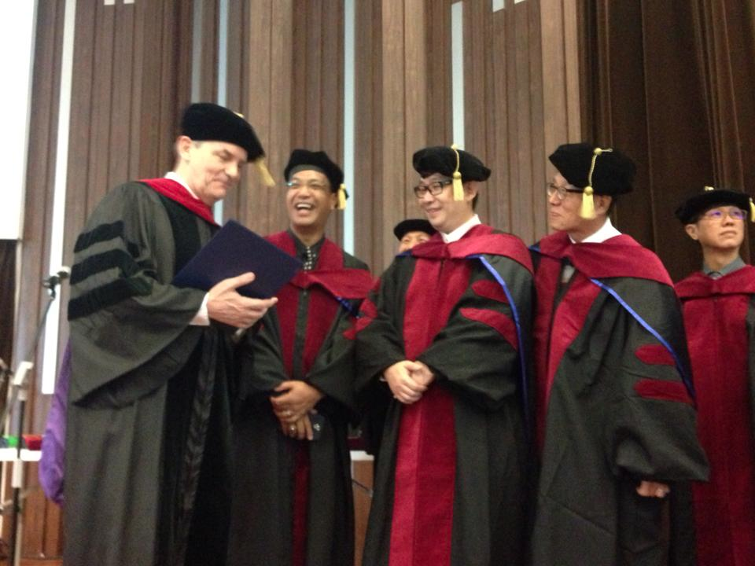
Doctor of Ministry Graduates 9 May 2015

Slide 9
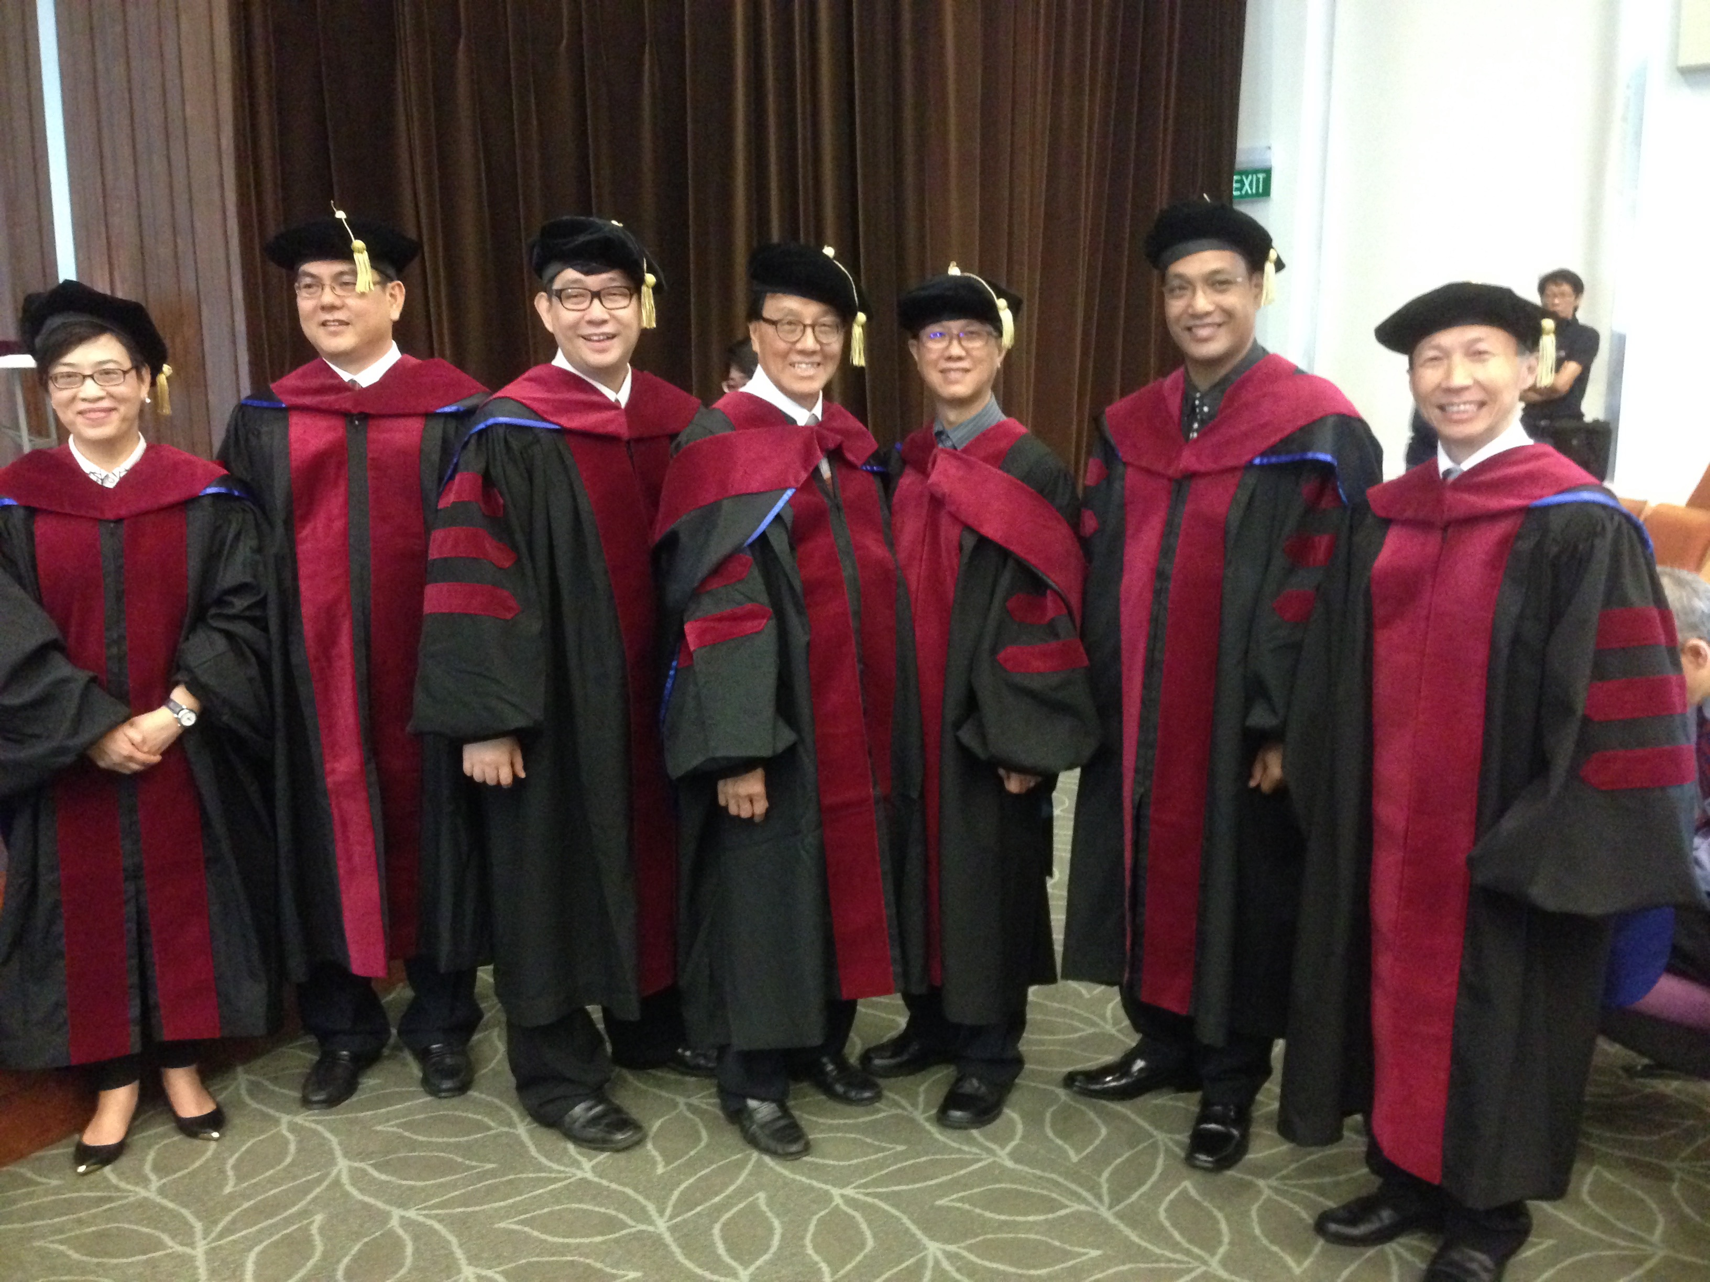
Seven DMin Graduates May 2015
Notes:
2 Chinese: Josephine Lau & Too Take Joie
5 English: Chandra Koewoso, Siew Who, Yap Beng Shin, Neil Mamburam, Alby Yip

Slide 10

"in the beginning"
Gen. 1:1
An Introduction to Genesis

Slide 11
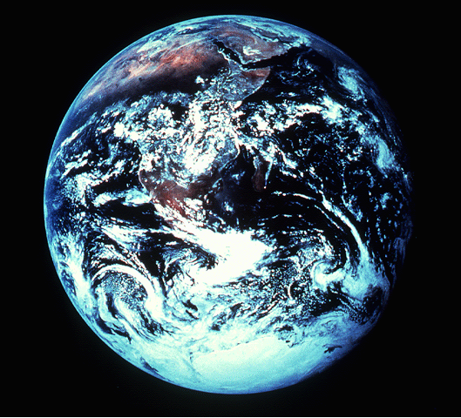
"pada mulanya"
Gen. 1:1
Pengenalan kitab Kejadian

Slide 12
"起初"
Gen. 1:1
创世记导论

Slide 13
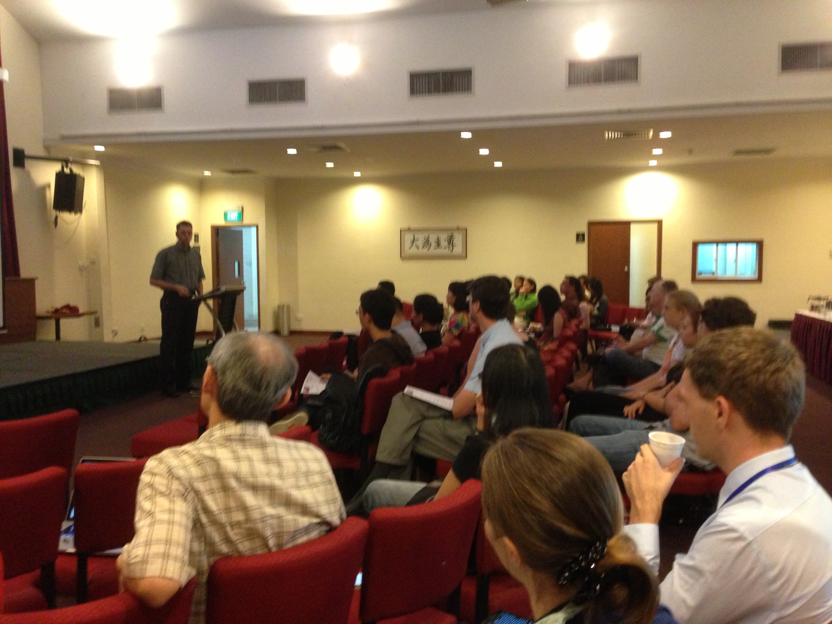

Our People
2015: 50 people from 12 nations

Slide 14
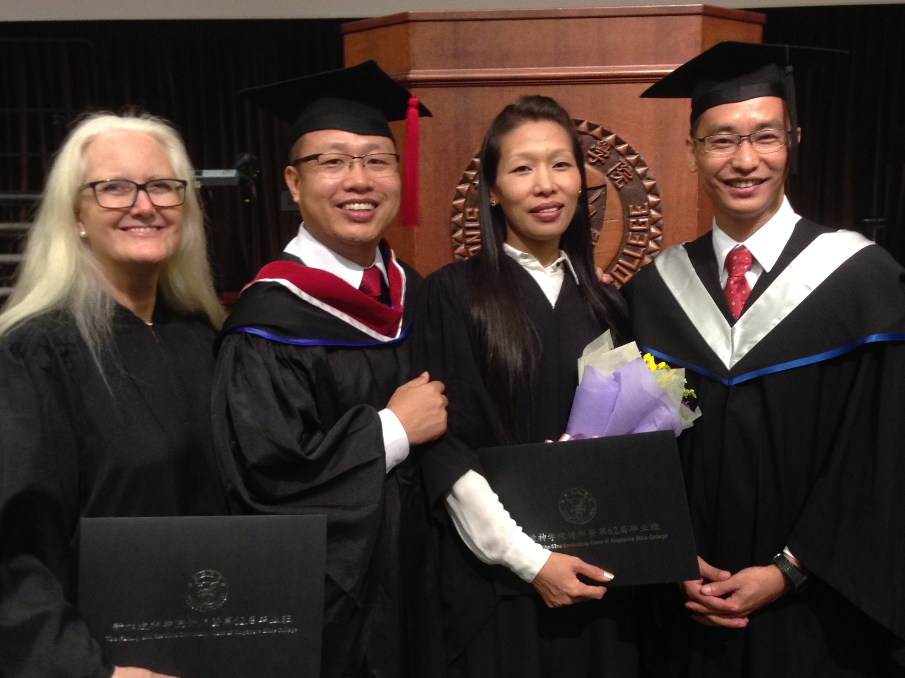
Crossroads Graduates
Colleen
Athan
Chanchan
Themshang
Notes:
On 9 May 2015 we saw four of our Crossroads International Church people graduate from SBC with four different degrees!

Slide 15

OT Sermons link at biblestudydownloads.com
Get this presentation for free!

Slide 16
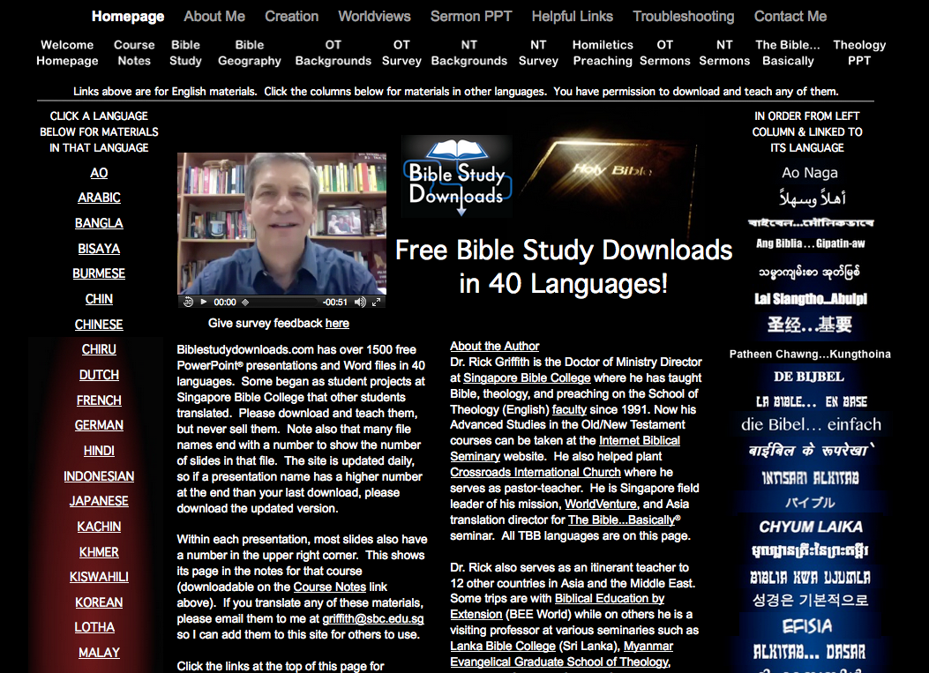
biblestudydownloads.com
7
Notes:
Student translations have resulted in Bible teaching and study materials—mostly PowerPoint—in 40 languages! All a teacher needs to do is to click on a file and it downloads for free to teach any book of the Bible and many other subjects.

Slide 17
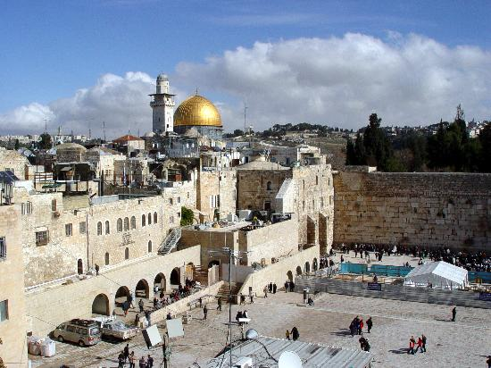
Jerusalem
December 1995
Notes:
God met me in Jerusalem in December 1995.
You see, at that time I had served on the faculty of Singapore Bible College for four years and I started teaching some courses for the fourth time––that can lose its challenge.
But the chance came to lead trips to Israel. I'd never been there before, but 25 daring souls braved to pay the $3000 to come with me.
But at the antiquities shop in Jerusalem I was stunned to see one of my tour members argue with the shop owner about the price of an artifact. "What? You want $20? I saw this for $18 down the street!"
I was so embarrassed that I left the shop, sat down on the curb, and pouted like Elijah. "What are you doing here, Rick?" I sensed God say to me (not audibly, yet still real).
"Lord, I'm bringing Your people to Your land to get to know Your Word."
"No, you're not," I sensed God saying to me. "You can't afford to come Israel so you rounded up 25 wealthy people to pay your way."
Then it struck me how little time Jesus spent in Jerusalem. Sure, he was a faithful Jew who made the required pilgrimages three times a year––and he spent the last week of his life in Jerusalem since he came there to die. But Jesus wasn't impressed with the wealth and power of Jerusalem.
Instead, he wanted to change the world through the poor. Jesus said that he had come to preach the gospel to the poor. And, as I thought about it, I realized that Jesus spent most of his ministry up in the poor north, in Galilee. He spent his time and energy in what people considered to be the place for roughnecks and insurrectionists.
Then I thought about the students that I had at SBC up to that point. I realized that the ones who came from the wealthy churches had to return back to their wealthy churches to pay back these churches for their support during seminary.
However, the ones from the poor countries returned to their countries had a tremendous impact for the cause of Christ.
So I said to the Lord, "OK, Lord, what do you want me to do? Where do you want me to go?"

Slide 18
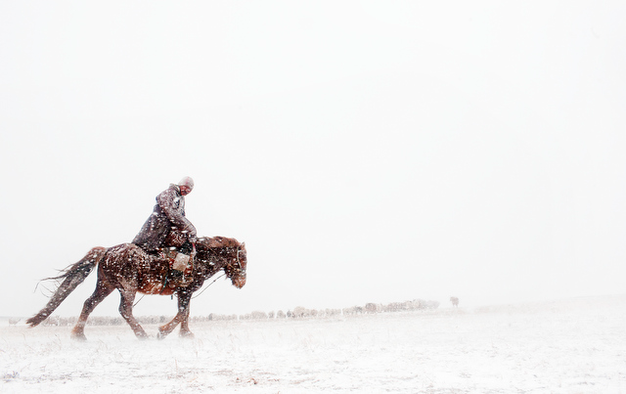
Mongolia
December 1995
Notes:
Then God put on my mind Mongolia. "Mongolia? Are you telling me to go to Outer Mongolia? I don't know a soul in Mongolia!"

Slide 19
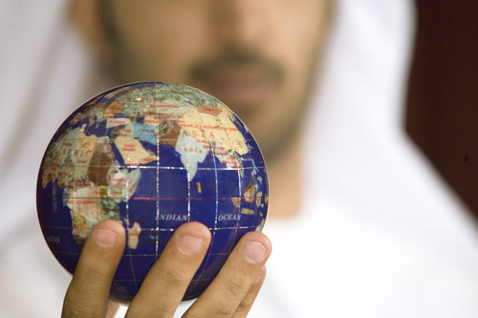
How can you know if God wants you to do a certain task?

Slide 20

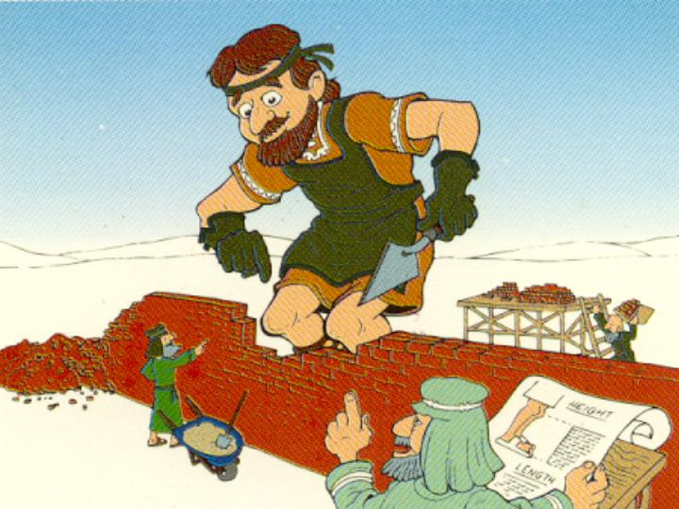
Our Key Word
Nehemiah:
Walls
Walk Through The Bible ©1989

Slide 21

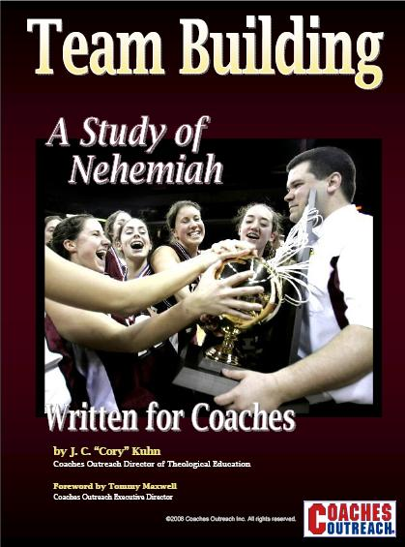
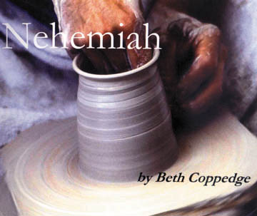
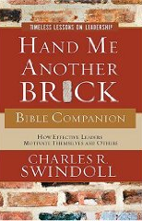
Books on Nehemiah

Slide 22
Nehemiah's Responses to Problems
305
Gene Getz, "Nehemiah," in The Bible Knowledge Commentary, 1:681
Problems
Responses
Walls broken and gates burned (1:2-3)
Grief and prayer (1:4), & motivation of the people to rebuild (2:17-18)
False accusation of the workers (2:19)
Confidence that God would give them success (2:20)
Ridicule of the workers (4:1-3)
Prayer (4:4-5) & action (greater diligence in the work, 4:6)
Plot to attack the workers (4:7-8)
Prayer & action (posting a guard, 4:9)
Physical exhaustion & threat of murder (4:10-12)
Positioning people by families with weapons (4:13, 16-18), encouraging the people (4:14, 20)
Economic crisis and greed (5:1-5)
Anger (5:6), reflection, rebuke (5:7), & action (having the people return the debtors' interest, 5:7b-11)

Slide 23
Nehemiah's Responses to Problems
305
Gene Getz, "Nehemiah," in The Bible Knowledge Commentary, 1:681
Problems
Responses
Plot to assassinate (or at least harm) Nehemiah (6:1-2)
Refusal to cooperate (6:3)
Slander against Nehemiah (6:5-7)
Denial (6:8) & prayer (6:9)
Plot to discredit Nehemiah (6:13)
Refusal to cooperate (6:11-13) & prayer (6:14)
Tobiah moved into a temple storeroom (13:4-7)
Tossing out Tobiah's furniture (13:8)
Neglect of temple tithes &
offerings (13:10)
Rebuke (13:11a), stationing the Levites at their posts (13:11b), & prayer (13:14)
Violation of the Sabbath by business activities (13:15-16)
Rebuke (13:17-18), posting of guards (13:19), & prayer (13:22)
Mixed marriages (13:23-24)
Rebuke (13:25-27), removal of a guilty priest (13:28), & prayer (13:29)

Slide 24
Nehemiah's Leadership
306
Donald K. Campbell, Nehemiah: Man in Charge, 23
While leadership is not the main purpose of the book, nevertheless, the man Nehemiah exemplifies many principles for good leadership. Some these include the following:
1. He established a reasonable & attainable goal.
2. He had a sense of mission.
3. He was willing to get involved.
4. He rearranged his priorities in order to accomplish his goal.
5. He patiently waited for God's timing.
6. He showed respect to his superior.
7. He prayed at crucial times.
8. He made his request with tact and graciousness.
9. He was well prepared and thought of his needs in advance.
10. He went through proper channels.

Slide 25
Nehemiah's Leadership
306
Donald K. Campbell, Nehemiah: Man in Charge, 23
While leadership is not the main purpose of the book, nevertheless, the man Nehemiah exemplifies many principles for good leadership. Some these include the following:
11. He took time (3 days) to rest, pray, & plan.
12. He investigated the situation firsthand.
13. He informed others only after he knew the size of the problem.
14. He identified himself as one with the people.
15. He set before them a reasonable & attainable goal.
16. He assured them God was in the project.
17. He displayed self-confidence in facing obstacles.
18. He displayed God's confidence in facing obstacles.
19. He did not argue with opponents.
20. He was not discouraged by opposition.
21. He courageously used the authority of his position.

Slide 26

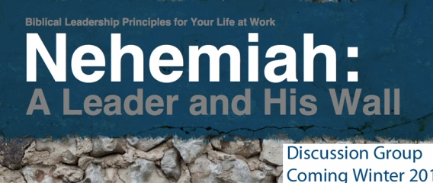

Books on Nehemiah

Slide 27
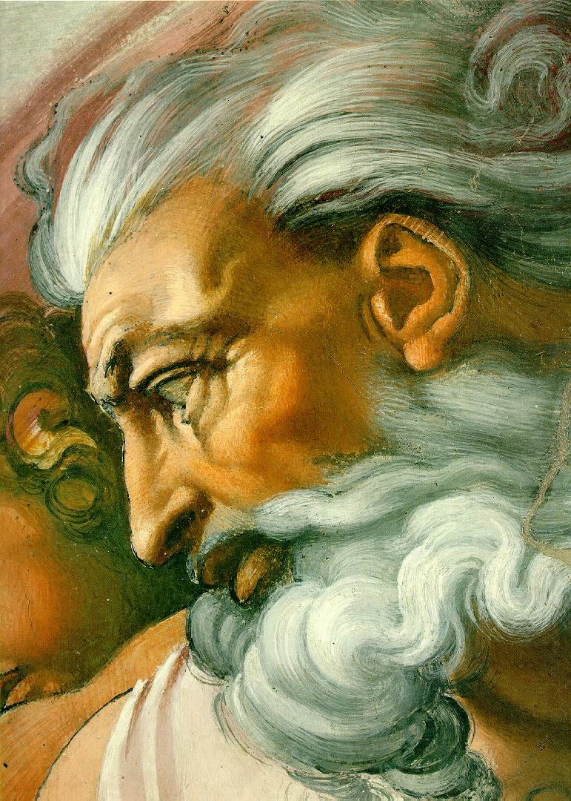
The Real Hero of the Book
Or
God?
Nehemiah?

Slide 28
Problems with the Leadership Focus
Author's intent
God is credited
Why, not how
Ezra-Neh. theme
Applies to all
Historical situation
Nehemiah?

Slide 29

Sin
JUDGMENT
IDOLATRY
WRATH
D A N I E L
E Z E K I E L
PUNISHMENT
SIN
DISOBEDIENCE

Slide 30
JUDAH IS PRESERVED!
Isaiah 9:6-7
DRESSING
THE
STAGE
Summing up…
MS
N(A)
H
SG
C
ER
B
J
MN
DS
E
KB
WHY?
U
MS
Because Messiah was long prophesied to appear through the tribe of Judah.
PG
RS
Handbook pg. 37-38
57
8

Slide 31
Z-E-N
Jer. 29:10; Ezra 3:8; Neh. 2:5-6
7
ZERUBBABEL…returns to begin rebuilding the Temple.
ZERUBBABEL
CAPTIVITY
EZRA…returns to teach the Law of the Lord.
EZRA
70 YEARS
Z-E-N
3 TREKS
100 YEARS / 50,000
Z - E - N
THREE DIPLOMATS
CAPTIVITY
NEHEMIAH
70 Years
NEHEMIAH…returns as the great Old Testament leader and rebuilder of the city's gates and its walls.
3 Treks
100 Years / 50,000
Z - E - N
Handbook pg. 37-38
66
3

Slide 32

Our Subject Today
God's Guidance

Slide 33
How can you know if God wants you to do a certain task?

Slide 34
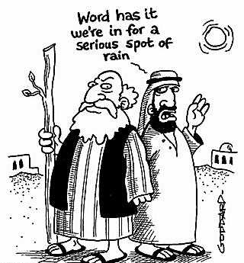
I. God gives us the information we need to do His will (1:1-3).
Hey Noah, word has it we're in for a serious spot of rain
Notes:
When the Lord has something for us to do, He always gives us the needed facts.

Slide 35
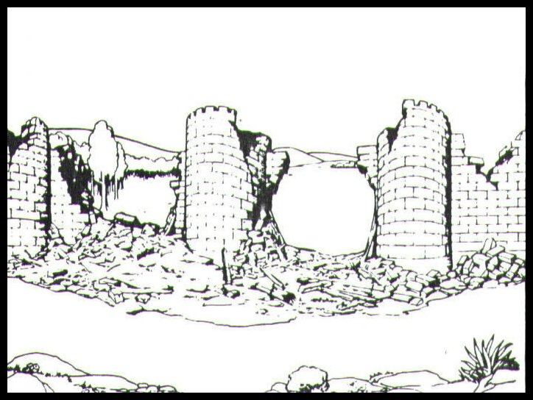
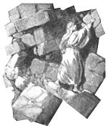
God informed Nehemiah of Jerusalem's sad state without a wall (1-3).

Slide 36
"These are the memoirs of Nehemiah son of Hacaliah.
In late autumn, in the month of Kislev, in the twentieth year of King Artaxerxes' reign, I was at the fortress of Susa. ²Hanani, one of my brothers, came to visit me with some other men who had just arrived from Judah. I asked them about the Jews who had returned there from captivity and about how things were going in Jerusalem.
³They said to me, 'Things are not going well for those who returned to the province of Judah. They are in great trouble and disgrace. The wall of Jerusalem has been torn down, and the gates have been destroyed by fire'"
(1:1-3 NLT).
Notes:
Tyndale House Publishers., Holy Bible : New Living Translation., 2nd ed. (Wheaton, Ill.: Tyndale House Publishers, 2004), Ne 1:1-3.

Slide 37

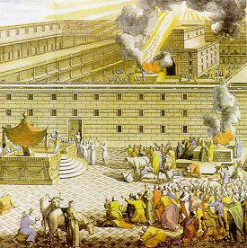
The Postexilic Era
560
The Postexilic Era
Temple work
Prophets:
Haggai
Zechariah
Malachi
605
586
539
536
520
516
483-473
444-425
Others:
Zerubbabel
Esther
Ezra
Nehemiah
Persian Kings:
Cyrus
Darius
Xerxes
Artaxerxes
Notes:
Nehemiah wrote from exile in Susa 100 years after the temple rebuilding. Three Persian kings had already come and gone, and it was now during the twentieth year of the Persian king Artaxerxes I, which was Nov-Dec 444 BC.

Slide 38

The Persian Empire
^{Susa}
The boundaries of the empire that Cyrus II initiated
and Darius I consolidated stretched from Greece to India

Slide 39
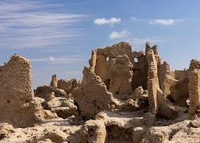
The Three "Rs" (1:3)
Remnant Small
Reproached Jews
Ruined Walls
Notes:
Why would it be so surprising to hear that the walls were broken down (3)? Weren't they broken down in 586 BC, which was over 100 years before? Yes, but perhaps Nehemiah had thought that they would have been rebuilt by now.

Slide 40


Borders of the Land Promised to Abraham
44
Genesis 15:18
"On that day the LORD made a covenant with Abram, saying, 'To your offspring I give this land, from the river of Egypt to the great river, the river Euphrates'" (ESV)
Notes:
40
Why was it so vital for Jerusalem to have walls? At least two reasons:
God promised Abraham that his descendants would occupy the land from the River of Egypt to the Euphrates (Gen. 15:18), yet Israel in Babylon was living outside of these boundaries. The nation needed to fully return to the land.
Secondly…

Slide 41
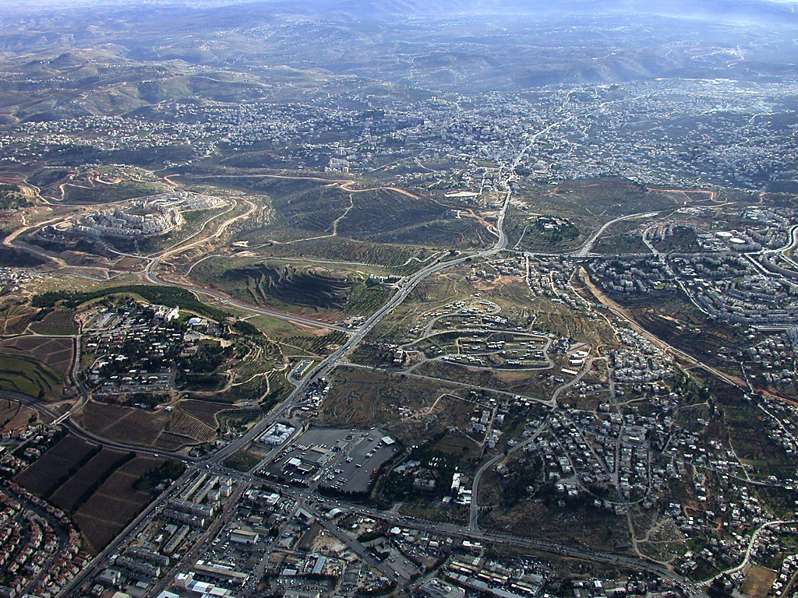
Bethlehem aerial from north
Herodium
Bethlehem
Church of Nativity
Rachel's Tomb
Har Homa
Tantur
Mar Elias
Ramat Rahel
Bethlehem aerial from north near Jerusalem
Notes:
41
2. The Messiah had already been prophesied to be born in Bethlehem (Micah 5:2).
____________
Bethlehem in the Old Testament
Bethlehem was the home of Micah's Levite priest (Jud 17:1-13).
Ruth harvested in the fields of Boaz in Bethlehem.
Three generations after Ruth, David was born in Bethlehem (Ruth was David's great-grandmother).
David was anointed king in Bethlehem (1 Sam 16:1-13), but he chose not to make this city his capital.
Bethlehem was the home of Joab, Abishai, and Asahel. Asahel was buried here (2 Sam 2:32).
Bethlehem was also the home of Elhanan, one of David's mighty men (2 Sam 23:24; 1 Chr 11:26).
Rehoboam fortified Bethlehem (2 Chr 11:6).
Many Jews fled to Bethlehem after Gedaliah was killed (Jer 41:17).
The city was rebuilt after the return from Babylonian exile (Ezra 2:21; Neh 7:25).
Bethlehem was named as the place of the Messiah's birth (Micah 5:2; John 7:42).

Slide 42
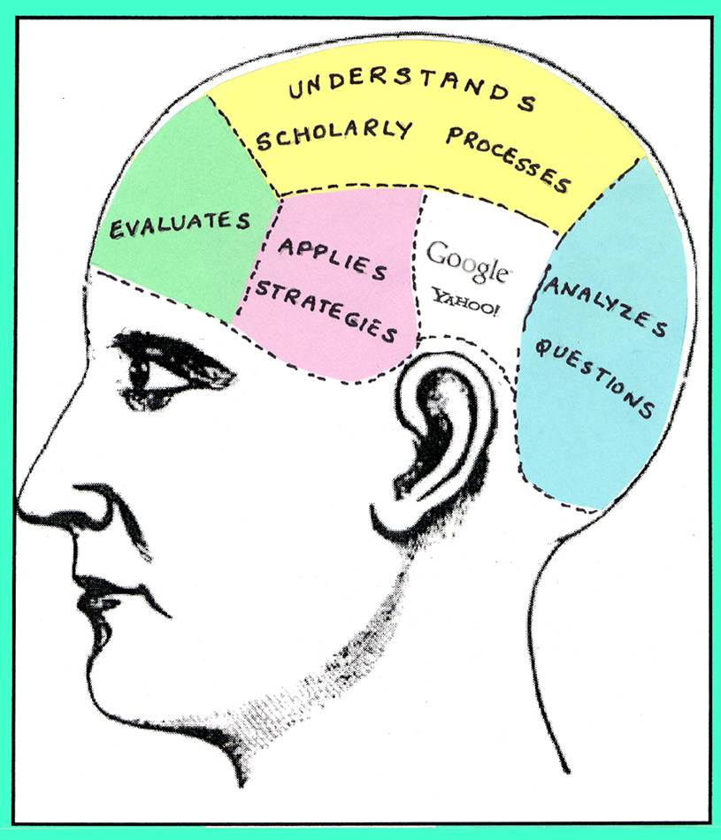

God also informs us how to serve Him.
Notes:
In this room we have a vast amount of knowledge in different areas—education, banking, business, missions, theology, etc. It's amazing to think about!

Slide 43
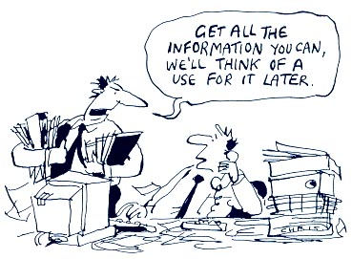
Get all the info you can…
Notes:
Of course, we live in an information-overload age. More info is not necessarily better. I'm just saying that God does inform us of what he wants us to do!

Slide 44
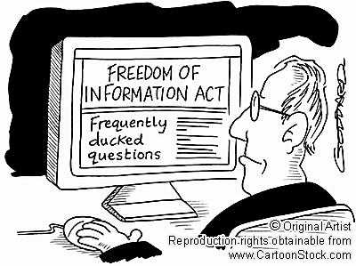
God wants you informed!
Notes:
One great thing about God is that He doesn't hide from us any info that we need!

Slide 45

Speaking of information…
Statistics on church guests show that:
• 85% of guests return if visited in 36 hours
• 60% of guests return if visited in 72 hours and
• 15% of guests return if visited in 7 days.
So follow up after they visit with a gift bag or something to thank them for visiting your church.
The Form Gallery, Issue #063 "How to Get Church Visitor Contact Information" 9 July 2013
Notes:
I wonder what God has recently informed you about? What's on your mind today? I recently learned that 85% of church guests return if visited within 36 hours, but this decreases to 60% if in 72 hours and 15% if visited in 7 days. People need soul care—is God calling you to care for souls?

Slide 46
Mongolia
January 1996
Notes:
Well, you may wonder what happened to my December 1995 prayer about Mongolia. I returned to Singapore and three weeks later in the new semester, in walked a young lady and sat right in the front row—right in front of me. He name was Sarnai, and—you guest it—she was from Mongolia! She also ended up babysitting our boys!

Slide 47
I. God gives us the information we need to do His will (1:1-3).
Hey Noah, word has it we're in for a serious spot of rain
Notes:
When the Lord has something for us to do, He always gives us the needed facts.

Slide 48

II. God gives us the vision we need to do His will (1:4-11a).
Notes:
When the Lord has something for us to do, He puts in us a burden for His plan.

Slide 49
"When I heard this, I sat down and wept. In fact, for days I mourned, fasted, and prayed to the God of heaven. ⁵Then I said,
⁶'O LORD, God of heaven, the great and awesome God who keeps his covenant of unfailing love with those who love him and obey his commands, listen to my prayer! Look down and see me praying night and day for your people Israel. I confess that we have sinned against you. Yes, even my own family and I have sinned! ⁷We have sinned terribly by not obeying the commands, decrees, and regulations that you gave us through your servant Moses"
(1:4-7 NLT).

Slide 50
'Please remember what you told your servant Moses: "If you are unfaithful to me, I will scatter you among the nations. ⁹But if you return to me and obey my commands and live by them, then even if you are exiled to the ends of the earth, I will bring you back to the place I have chosen for my name to be honored."
¹⁰'The people you rescued by your great power and strong hand are your servants. ¹¹O Lord, please hear my prayer! Listen to the prayers of those of us who delight in honoring you. Please grant me success today by making the king favorable to me. Put it into his heart to be kind to me'" (1:8-11a NLT).

Slide 51
Impossible project?
Notes:
This seemed an impossible project—how could he build a huge wall in a city months of travel away? No money… no contractors… no building experience… no time off from work… But God gave him vision!
In Nehemiah's prayer, we see that God moved Nehemiah to recognize both Israel's sin and His promises and ability to restore the nation.

Slide 52
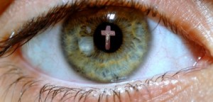
Focus on God
Focus on
He was called "the God of heaven" (4b).
He was "the great and awesome God who keeps his covenant of love…" (5).
God listens to prayer (6, 11a).
God graciously gave commands, decrees, and laws through Moses (7).
God promised not only exile but also return (8-9).
God redeemed this remnant by His great strength (10)
Notes:
It's true that Nehemiah cared enough to ask (2), and Nehemiah cared enough to weep (4a), but notice how he focuses attention on God here (4b-11a)…

Slide 53
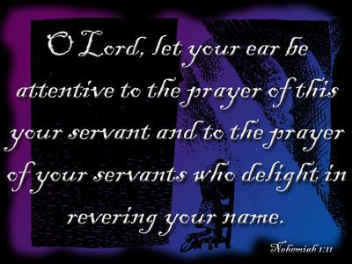
The end of his prayer…
Notes:
The end of his prayer focuses on God as well (1:11)

Slide 54
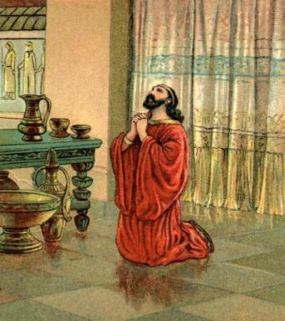
Nehemiah was open to God.
Notes:
It's interesting how this day in Nehemiah's life likely began as did any other—he got up, did his job, etc.—but he was open to God giving him a vision that day that would change his life and the life of Israel through him forever!

Slide 55
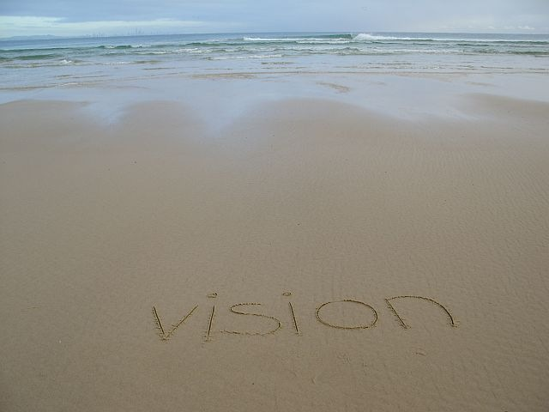
God also gives us a vision to serve Him. What's on your heart today?

Slide 56
Wiersbe on God's Leading…
"Like large doors, great life-changing events can swing on very small hinges. It was just another day when Moses went out to care for his sheep, but on that day he heard the Lord's call and became a prophet (Ex. 3). It was an ordinary day when David was called home from shepherding his flock; but on that day, he was anointed king (1 Sam. 16). It was an ordinary day when Peter, Andrew, James, and John were mending their nets after a night of failure; but that was the day Jesus called them to become fishers of men (Luke 5:1–11)."
Notes:
This often happens in an otherwise mundane day.

Slide 57
Wiersbe on God's Leading…
"You never know what God has in store, even in a commonplace conversation with a friend or relative; so keep your heart open to God's providential leading. I attended a birthday party one evening when I was nineteen years old, and a statement made to me there by a friend helped direct my life into the plans God had for me; and I will be forever grateful."
Warren W. Wiersbe, Be Determined (Wheaton, Ill.: Victor Books, 1992), Neh. 1:1.

Slide 58
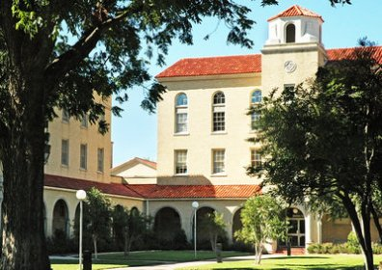

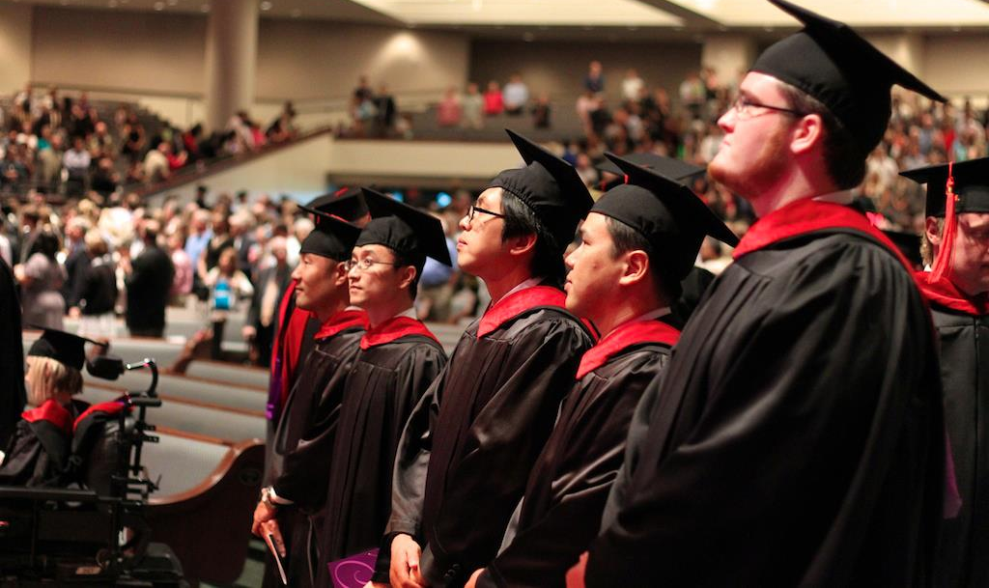
Just a simple word…
Notes:
That reminds me of my fear of attending Dallas Seminary when I was 23 years old. I had a good friend that went to Dallas and didn't survive his first semester. He said he stayed up until midnight studying every night but still flunked Greek and had to leave the school. He noted, "The guys that passed stayed up to 2 AM." I remember saying to my roommate, "There's no way I could ever learn Greek and Hebrew. I'm terrible at languages too." My roommate John replied, "Rick, you could do it." God used John's statement of confidence to change my life, giving me the faith to trust Him. Little did I realize that I would not only be able to pass at DTS, but I would learn Greek, Hebrew, French and German and go on to get my PhD there too. The encouragement of others is great, but ultimately it is God behind it all to provide the passion to do His will.

Slide 59
I. God gives us the information we need to do His will (1:1-3).
Word has it we're in for a serious spot of rain

Slide 60
II. God gives us the vision we need to do His will (1:4-11a).

Slide 61
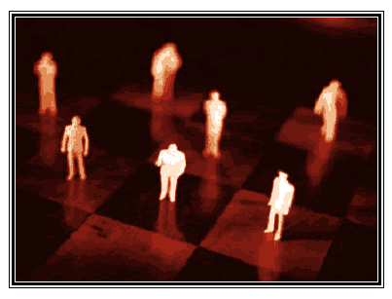
III. God gives us the position we need to do His will (1:11b).
"I was cupbearer to the king" (Neh. 1:11b)
Notes:
When the Lord has something for us to do, He puts us in the right place at the right time.

Slide 62
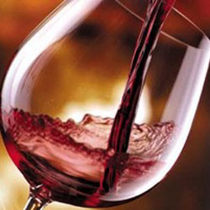
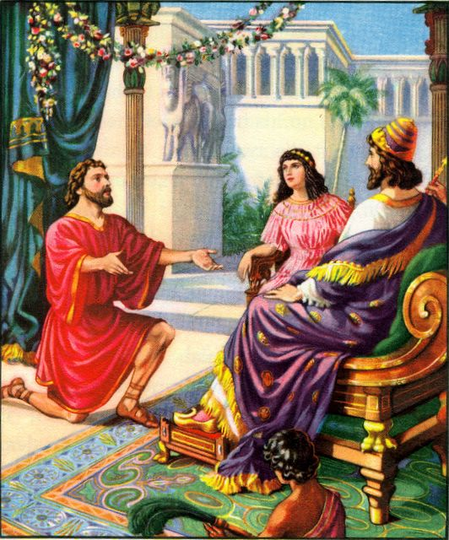
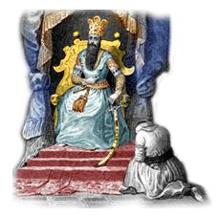
The Cupbearer
Wiersbe again…
Notes:
Wiersbe also notes, "A cupbearer was much more than our modern 'butler' (see Gen. 40). It was a position of great responsibility and privilege. At each meal, he tested the king's wine to make sure it wasn't poisoned. A man who stood that close to the king in public had to be handsome, cultured, knowledgeable in court procedures, and able to converse with the king and advise him if asked (see 41:1–13). Because he had access to the king, the cupbearer was a man of great influence, which he could use for good or for evil." "That Nehemiah, a Jew, held such an important position in the palace speaks well of his character and ability (Dan. 1:1–4). For nearly a century, the Jewish remnant had been back in their own land, and Nehemiah could have joined them; but he chose to remain in the palace. It turned out that God had a work for him to do there that he could not have accomplished elsewhere. God put Nehemiah in Susa just as He had put Esther there a generation before, and just as He had put Joseph in Egypt and Daniel in Babylon. When God wants to accomplish a work, He always prepares His workers and puts them in the right places at the right time."
Ibid.

Slide 63
Mongolia
July 2013
Notes:
So what happened regarding Mongolia? The physical climate hasn't changed––but the spiritual climate sure has!
On my first trip to teach preaching there in 1997, three of my 34 students volunteered to preach in the class. All three became pastors, all three have graduated from SBC with their master degree, and returned to train hundreds of more pastors.
We have had over 11 Mongols graduate from SBC!

Slide 64
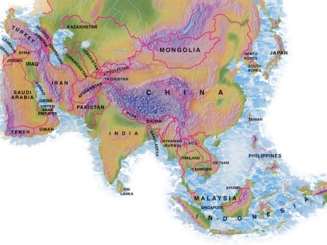
Teaching Ministry 1997-2015
MONGOLIA
JORDAN
KOREA
CHINA
NEPAL
MYANMAR
INDIA
THAILAND
VIETNAM
MALAYSIA
SRI LANKA
SINGAPORE
SBC
INDONESIA
Notes:
From 1997-July 2013 God has seen fit to grant me the privilege to train pastors in 12 other countries on 53 trips. This year I still have Malaysia and Vietnam while next year I have Korea, Mongolia and Thailand in the plans for ministry.

Slide 65
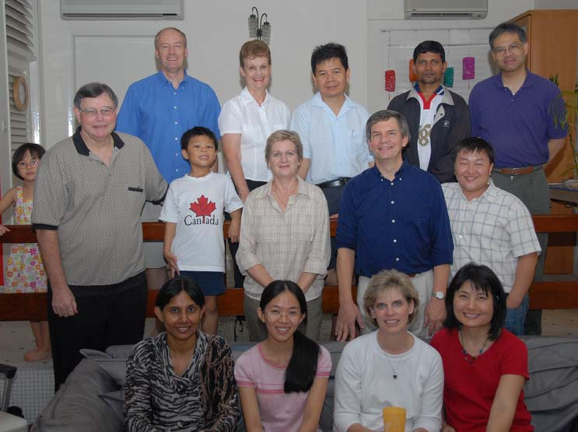
17 believers from 6 countries at our first meeting Friday, 6 Oct 06
Notes:
65
In 2006 God put me in a similar place of need. I agonized over the need in Singapore for more international churches with expository teaching—as did some friends were like Hanani was to Nehemiah. We first met together in October 2006 and prayed, and Crossroads International Church was born a month later on 19 November 2006.

Slide 66
How can you know if God wants you to do a certain task?
Notes:
So what's the big idea in this chapter?

Slide 67
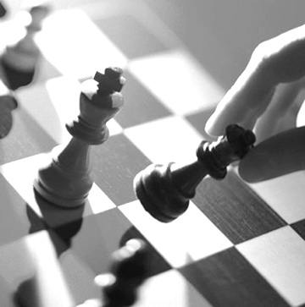

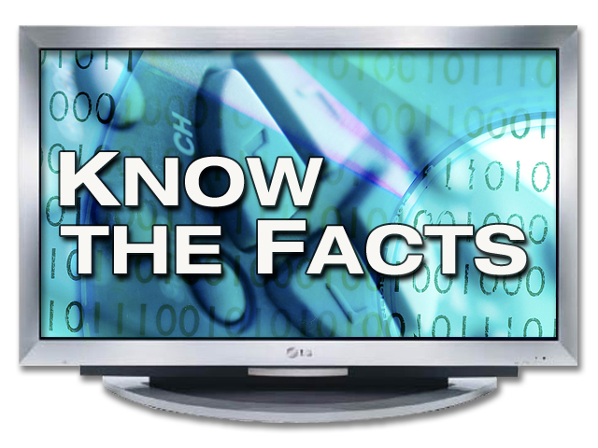
Key Idea of Nehemiah 1
God gives you the
information, vision, & position
KNOW THE FACTS
vision
you need to do His will.

Slide 68
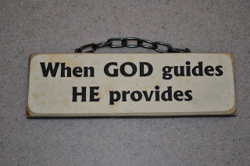
Where God guides,
God provides
Notes:
He always equips us to accomplish His will.

Slide 69
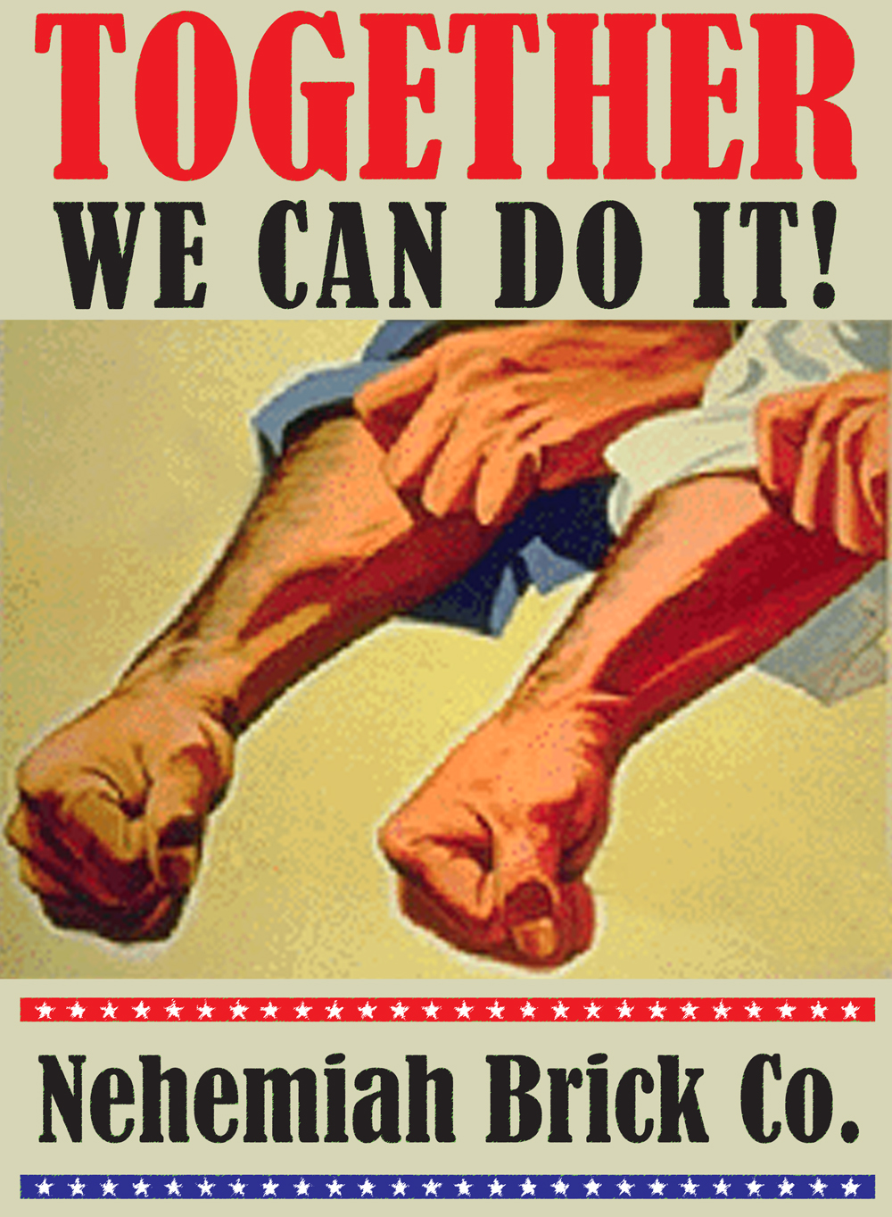
Where God guides, we must respond!
Notes:
I came across this ad based on the Rosie the Riveter theme. It's not all us and it's not all God. Amazingly, he calls us into partnership with himself!

Slide 70

Black
Notes:
In 2009 Evan shared with me his vision to set up a coffee station at the door. He's in banking and this is below his abilities, but he had the vision to do it. He only asked me for the position of influence, so I said, "You're hired!" We have had our coffee and tea and snacks table now for four years, even though Evan now serves in Hong Kong. But it started with a vision.

Slide 71

What knowledge, faith, and place of influence has God given you?
What does God want you to do with it?
Notes:
What knowledge, faith, and place of influence has He given you? What does God want you to do with it? What burden has the Lord placed on your heart? Soul care? How can we help you achieve this vision so you have all you need to do His will?

Slide 72
Black
Notes:
Let's pray…

Slide 73


OT Sermons link at BibleStudyDownloads.org
Get this presentation and script for free!

